Slide 1

Customer Shopping Behavior Analysis
Uncovering insights from transactional data to guide strategic decisions.

Slide 2
Project Overview
1
2
3
Transactional Data
Key Insights
Strategic Decisions
Analyzed 3,900 purchases across categories.
Spending patterns, customer segments, product preferences.
Guiding business strategy with data-driven insights.

Slide 3
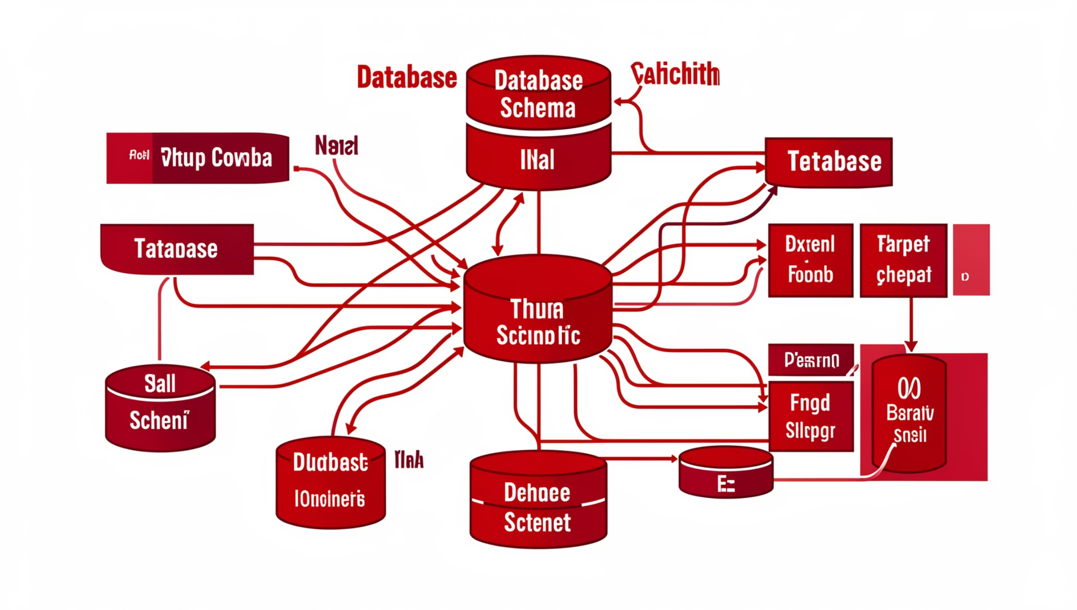
Dataset Summary
Data Dimensions
Rows: 3,900
Columns: 18
Key Features
Customer demographics
Purchase details
Shopping behavior

Slide 4
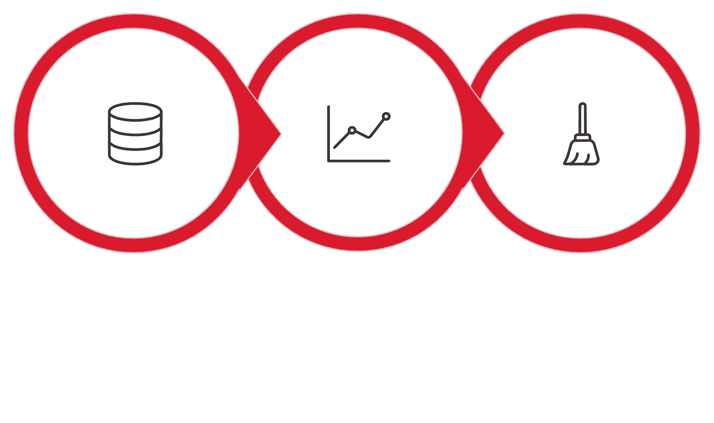



Exploratory Data Analysis (Python)
Data Loading
Initial Exploration
Data Cleaning
Data preparation and cleaning using Python for robust analysis.

Slide 5



Data Analysis using SQL
Revenue by Gender
Top 5 Products
Shipping Type
Male: $157,890
Gloves, Sandals, Boots, Hat, Skirt
Express: $60.48 avg.
Female: $75,191
Standard: $58.46 avg.

Slide 6
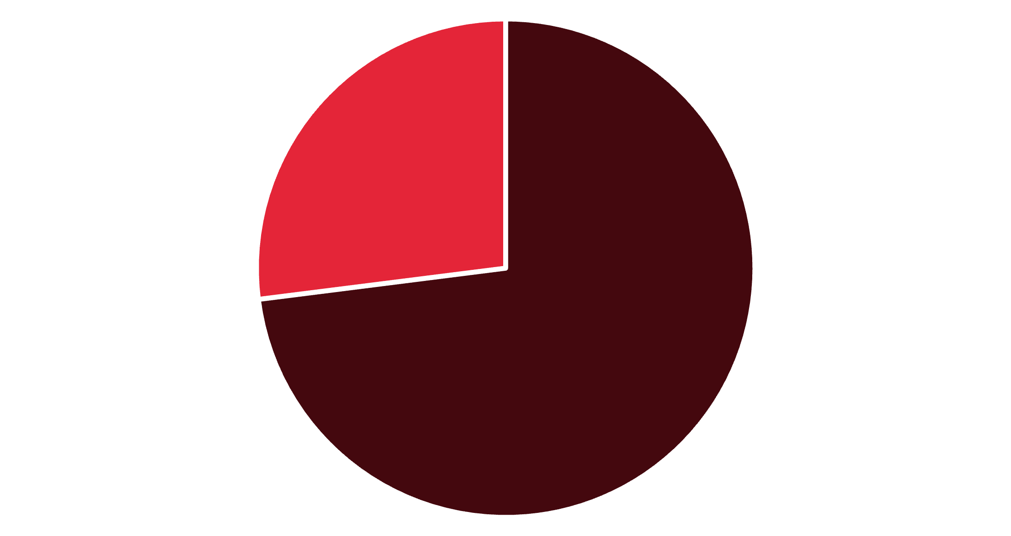
Subscription & Discount Insights
Subscribers vs. Non-Subscribers
Subscribers: $62,645 total revenue
Non-Subscribers: $170,436 total revenue
Discount-Dependent Products
Hat: 50% discounted
Sneakers: 49.66% discounted
No
Yes

Slide 7



Customer Segmentation
New
83 customers
Returning
701 customers
Loyal
3,116 customers
Classifying customers based on purchase history.

Slide 8
Top Products by Category
1
Accessories
Jewelry
171
1
Clothing
Blouse
171
1
Footwear
Sandals
160
1
Outerwear
Jacket
163
Most purchased products within each category.

Slide 9
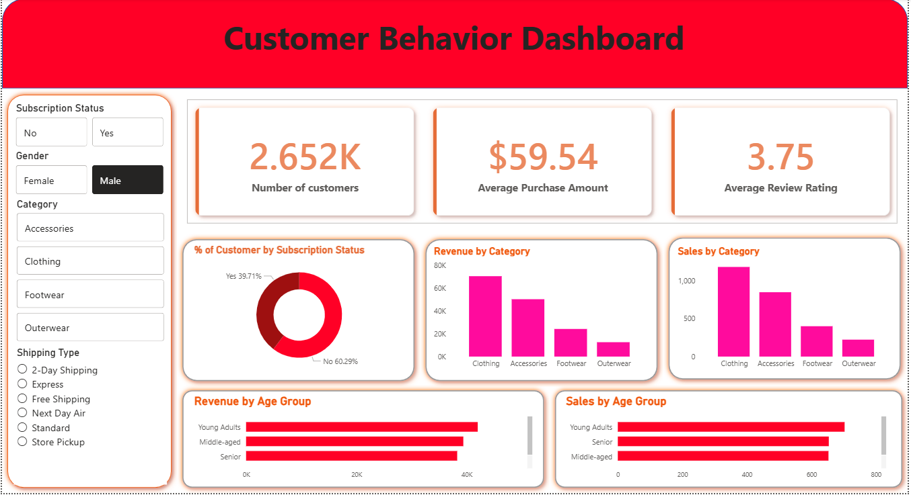
Power BI Dashboard
Interactive dashboard for visual insights.

Slide 10
Business Recommendations
1
Boost Subscriptions
2
Customer Loyalty
Promote exclusive benefits.
Reward repeat buyers.
3
Review Discount Policy
4
Targeted Marketing
Balance sales with margin.
Focus on high-revenue groups.

